Slide 1
Notations
Prepared by: Afaq Mansoor Khan
BSSE III- Group A
Session 2017-21
IMSciences, Peshawar.

Slide 2
Last Lecture Summary
Introduction to Stack Data Structure
Stack Operations
Analysis of Stack Operations
Applications of Stack Data Structure in Computer Science

Slide 3
Objectives Overview
Notations
Prefix, Infix and Postfix Notations
Conversion of one type expression to another
Evaluation of Prefix and Postfix Notations

Slide 4
Notation
The way to write arithmetic expression is known as a notation. An arithmetic expression can be written in three different but equivalent notations, i.e., without changing the essence or output of an expression. These notations are:
Infix Notation
Prefix Notation
Postfix Notation
These notations are named as how they use operator in expression. The terms infix, prefix, and postfix tell us whether the operators go between, before, or after the operands.

Slide 5
Infix Notation
We write expression in infix notation, e.g. a - b + c, where operators are used in-between operands. It is easy for us humans to read, write, and speak in infix notation but the same does not go well with computing devices. An algorithm to process infix notation could be difficult and costly in terms of time and space consumption.

Slide 6
Parentheses
Evaluate 2+3*5.
+ First:
(2+3)*5 = 5*5 = 25
* First:
2+(3*5) = 2+15 = 17
Infix notation requires Parentheses.

Slide 7
Prefix Notation
In this notation, operator is prefixed to operands, i.e. operator is written ahead of operands. For example, +ab. This is equivalent to its infix notation a + b. Prefix notation is also known as Polish Notation.

Slide 8
Parentheses
Evaluate + 2 * 3 5
+ 2 * 3 5 =
= + 2 * 3 5
= + 2 15 = 17
* + 2 3 5 =
= * + 2 3 5
= * 5 5 = 25
No parentheses needed!

Slide 9
Postfix Notation
This notation style is known as Reversed Polish Notation. In this notation style, the operator is postfixed to the operands i.e., the operator is written after the operands. For example, ab+. This is equivalent to its infix notation a + b.

Slide 10
Parentheses
Evaluate 2 3 5 * +
2 3 5 * + =
= 2 3 5 * +
= 2 15 + = 17
2 3 + 5 * =
= 2 3 + 5 *
= 5 5 * = 25
No parentheses needed here either!

Slide 11
Fully Parenthesized Expression
A FPE has exactly one set of Parentheses enclosing each operator and its operands.
Which one is fully parenthesized?
( A + B ) * C
( ( A + B) * C )
( ( A + B) * ( C ) )

Slide 12
Conversion from Infix to Postfix

Slide 13
Conversion from Infix to Postfix
Infix: ( ( ( A + B ) * C ) - ( ( D + E ) / F ) )
Postfix: A B + C * D E + F / -
Operand order does not change!
Operators are in order of evaluation!

Slide 14
Infix to Postfix - Algorithm
Initialize a Stack for operators, output list.
Split the input into a list of tokens.
for each token (left to right):
if it is operand: append to output
if it is '(': push onto Stack
if it is ')': pop & append till '('

Slide 15
FPE Infix to Postfix
( ( ( A + B ) * ( C - E ) ) / ( F + G ) )
stack: <empty>
output: []

Slide 16
FPE Infix to Postfix
( ( A + B ) * ( C - E ) ) / ( F + G ) )
stack: (
output: []

Slide 17
FPE Infix to Postfix
( A + B ) * ( C - E ) ) / ( F + G ) )
stack: ( (
output: []

Slide 18
FPE Infix to Postfix
A + B ) * ( C - E ) ) / ( F + G ) )
stack: ( ( (
output: []

Slide 19
FPE Infix to Postfix
+ B ) * ( C - E ) ) / ( F + G ) )
stack: ( ( (
output: [A]

Slide 20
FPE Infix to Postfix
B ) * ( C - E ) ) / ( F + G ) )
stack: ( ( ( +
output: [A]

Slide 21
FPE Infix to Postfix
) * ( C - E ) ) / ( F + G ) )
stack: ( ( ( +
output: [A B]

Slide 22
FPE Infix to Postfix
* ( C - E ) ) / ( F + G ) )
stack: ( (
output: [A B + ]

Slide 23
FPE Infix to Postfix
( C - E ) ) / ( F + G ) )
stack: ( ( *
output: [A B + ]

Slide 24
FPE Infix to Postfix
C - E ) ) / ( F + G ) )
stack: ( ( * (
output: [A B + ]

Slide 25
FPE Infix to Postfix
- E ) ) / ( F + G ) )
stack: ( ( * (
output: [A B + C ]

Slide 26
FPE Infix to Postfix
E ) ) / ( F + G ) )
stack: ( ( * ( -
output: [A B + C ]

Slide 27
FPE Infix to Postfix
) ) / ( F + G ) )
stack: ( ( * ( -
output: [A B + C E ]

Slide 28
FPE Infix to Postfix
) / ( F + G ) )
stack: ( ( *
output: [A B + C E - ]

Slide 29
FPE Infix to Postfix
/ ( F + G ) )
stack: (
output: [A B + C E - * ]

Slide 30
FPE Infix to Postfix
( F + G ) )
stack: ( /
output: [A B + C E - * ]

Slide 31
FPE Infix to Postfix
F + G ) )
stack: ( / (
output: [A B + C E - * ]

Slide 32
FPE Infix to Postfix
+ G ) )
stack: ( / (
output: [A B + C E - * F ]

Slide 33
FPE Infix to Postfix
G ) )
stack: ( / ( +
output: [A B + C E - * F ]

Slide 34
FPE Infix to Postfix
) )
stack: ( / ( +
output: [A B + C E - * F G ]

Slide 35
FPE Infix to Postfix
)
stack: ( /
output: [A B + C E - * F G + ]

Slide 36
FPE Infix to Postfix
stack: <empty>
output: [A B + C E - * F G + / ]

Slide 37
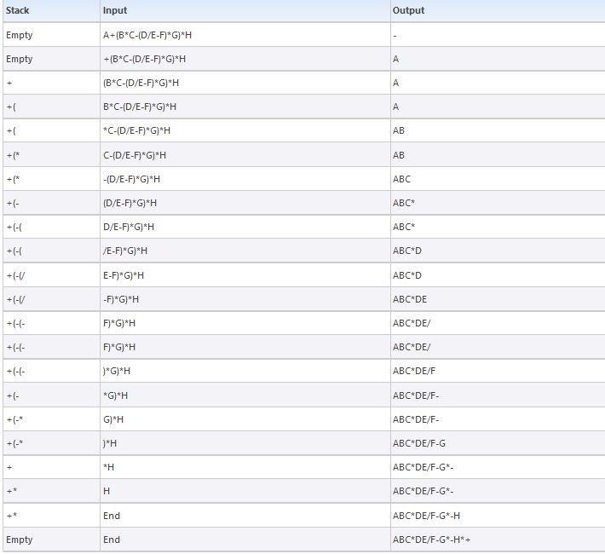

Slide 38
Infix to Prefix Conversion

Slide 39
Infix to Prefix - Algorithm
Reverse the infix expression i.e A+B*C will become C*B+A. Note while reversing each ‘(‘ will become ‘)’ and each ‘)’ becomes ‘(‘.
Obtain the postfix expression of the modified expression i.e CB*A+.
Reverse the postfix expression. Hence in our example prefix is +A*BC.

Slide 40
Infix to Prefix Conversion
Move each operator to the left of its operands & remove the parentheses:
( ( A + B) * ( C + D ) )

Slide 41
Infix to Prefix Conversion
Move each operator to the left of its operands & remove the parentheses:
( + A B * ( C + D ) )
Notes:
Start with Fully parenthesized expression. Move each operator to the left of its operands and remove the set of parentheses.

Slide 42
Infix to Prefix Conversion
Move each operator to the left of its operands & remove the parentheses:
* + A B ( C + D )
Notes:
Start with Fully parenthesized expression. Move each operator to the left of its operands and remove the set of parentheses.

Slide 43
Infix to Prefix Conversion
Move each operator to the left of its operands & remove the parentheses:
* + A B + C D
Order of operands does not change!
Notes:
Start with Fully parenthesized expression. Move each operator to the left of its operands and remove the set of parentheses.

Slide 44
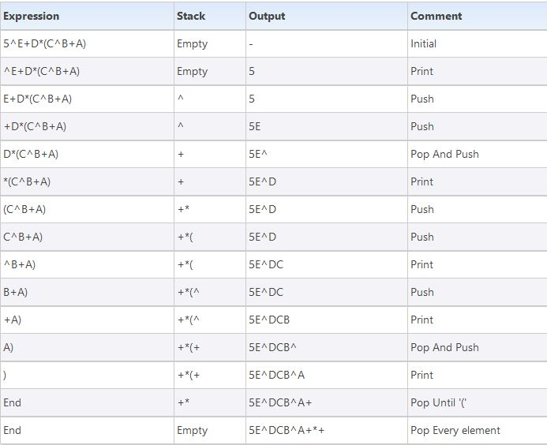

Slide 45
Postfix to Infix Conversion

Slide 46
Algorithm
While there are input symbol left
Read the next symbol from input.
If the symbol is an operand
Push it onto the stack.
Otherwise,
the symbol is an operator.
If there are fewer than 2 values on the stack
Show Error /* input not sufficient values in the expression */
Else
Pop the top 2 values from the stack.
Put the operator, with the values as arguments and form a string.
Encapsulate the resulted string with parenthesis.
Push the resulted string back to stack.
If there is only one value in the stack
That value in the stack is the desired infix string.
If there are more values in the stack
Show Error /* The user input has too many values */

Slide 47
Prefix to Infix Conversion

Slide 48
Algorithm
The reversed input string is completely pushed into a stack.
prefixToInfix(stack)
2.IF stack is not empty
a. Temp -->pop the stack
b. IF temp is a operator
Write a opening parenthesis to output
prefixToInfix(stack)
Write temp to output
prefixToInfix(stack)
Write a closing parenthesis to output
c. ELSE IF temp is a space -->prefixToInfix(stack)
d. ELSE
Write temp to output
IF stack.top NOT EQUAL to space -->prefixToInfix(stack)

Slide 49
Prefix to Postfix Conversion

Slide 50
Algorithm
Read the Prefix expression in reverse order (from right to left)
If the symbol is an operand, then push it onto the Stack
If the symbol is an operator, then pop two operands from the Stack Create a string by concatenating the two operands and the operator after them. string = operand1 + operand2 + operator And push the resultant string back to Stack
Repeat the above steps until end of Prefix expression.

Slide 51
Postfix to Prefix Conversion

Slide 52
Algorithm
Read the Postfix expression from left to right
If the symbol is an operand, then push it onto the Stack
If the symbol is an operator, then pop two operands from the Stack Create a string by concatenating the two operands and the operator before them. string = operator + operand2 + operand1 And push the resultant string back to Stack
Repeat the above steps until end of Prefix expression.

Slide 53
Postfix Evaluation

Slide 54
Postfix Evaluation Algorithm
Step 1 − scan the expression from left to right
Step 2 − if it is an operand push it to stack
Step 3 − if it is an operator pull operand from stack and perform operation
Step 4 − store the output of step 3, back to stack
Step 5 − scan the expression until all operands are consumed
Step 6 − pop the stack and perform operation

Slide 55
Prefix Evaluation

Slide 56
Prefix Evaluation Algorithm
Put a pointer P at the end of the end
If character at P is an operand push it to Stack
If the character at P is an operator pop two elements from the Stack. Operate on these elements according to the operator, and push the result back to the Stack
Decrement P by 1 and go to Step 2 as long as there are characters left to be scanned in the expression.
The Result is stored at the top of the Stack, return it
End

Slide 57
Summary
Notations
Prefix, Infix and Postfix Notations
Conversion of one type expression to another
Evaluation of Prefix and Postfix Notations

Slide 58
References
http://scanftree.com/Data_Structure/
https://www.geeksforgeeks.org/convert-infix-prefix-notation/
https://www.tutorialspoint.com/data_structures_algorithms/expression_parsing.htm

